Slide 1

Assignment 2: YouTube API

Slide 2



Group 11
Muhammad Wajahat Ali Khan
Inderpreet Singh
Syed Muhammad Bilal Munir

Slide 3
Select your favorite API. Why did you choose this API?
API Chosen: YouTube API.
The API is readily available online and in a good formatted way. Developers may create apps that integrate YouTube features, personalize the video viewing experience, and automate processes using the robust set of tools provided by the YouTube API.

Slide 4
How did you get the authorization for using the API data.
On the Google API Console, create a project: Create a new project, activate the YouTube API, and navigate to the Google API Console (console.developers.google.com).
Generate API credentials for your project by selecting the right type of credentials based on your use case. For instance, you'll need to generate OAuth 2.0 credentials if you wish to access YouTube data on someone else's behalf.
Authorization configuration: Setup authorisation for your API credentials. Depending on the kind of credentials you made, this will happen. You must set up the approved redirect URIs and give the required scopes for OAuth 2.0 credentials.
Get an access token: Following the configuration of authorisation, you can acquire an access token that enables you to make requests to the YouTube API.
Make API requests: With your access token, you can make requests to the YouTube API using your preferred programming language and library.

Slide 5
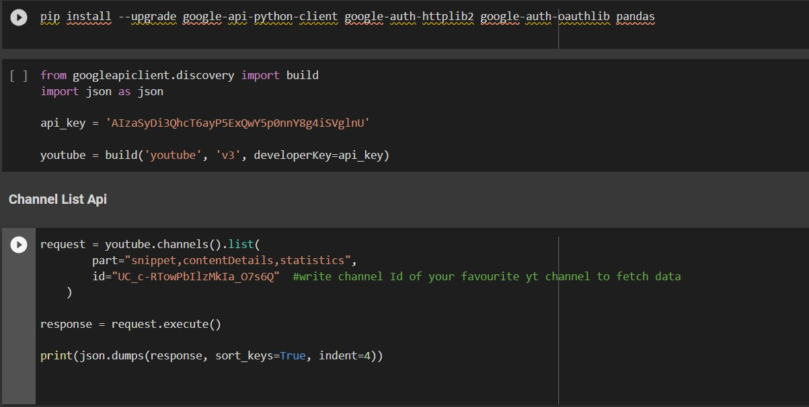
Read the API documentation and following the examples shown in class. Write a code to access data

Slide 6
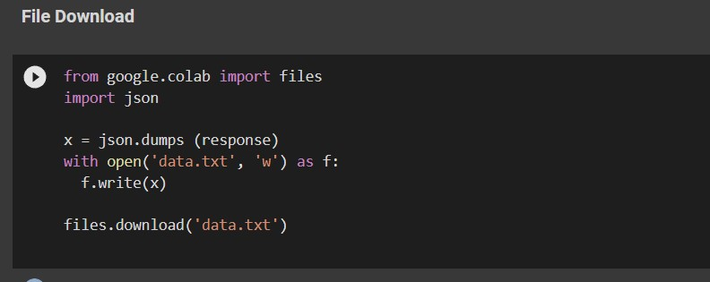
Download data in JSON, GEOJSON(if available), and Text formats. Tell us about the data

Slide 7
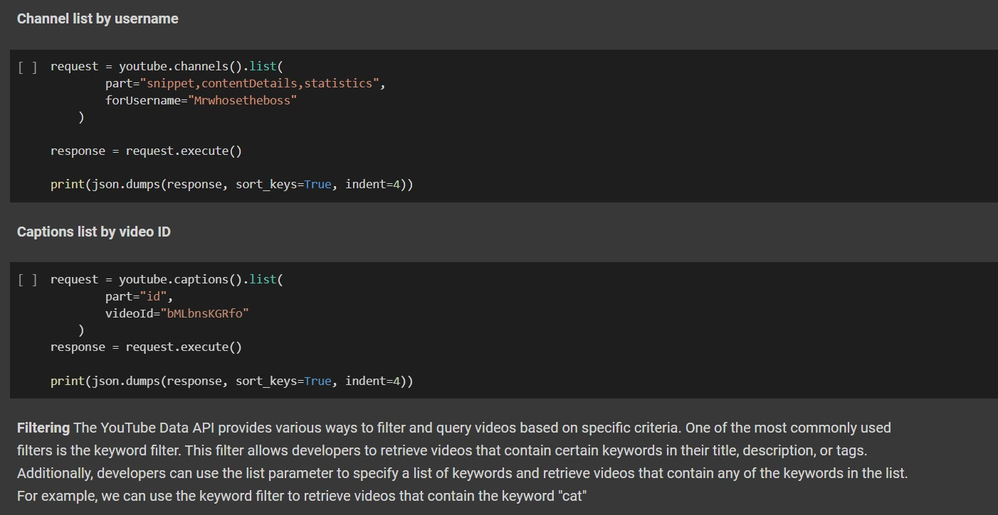
Show how to filter data for download. For example a) datatype b) date/time range, c) geographical region, d) ID (discuss queries)

Slide 8
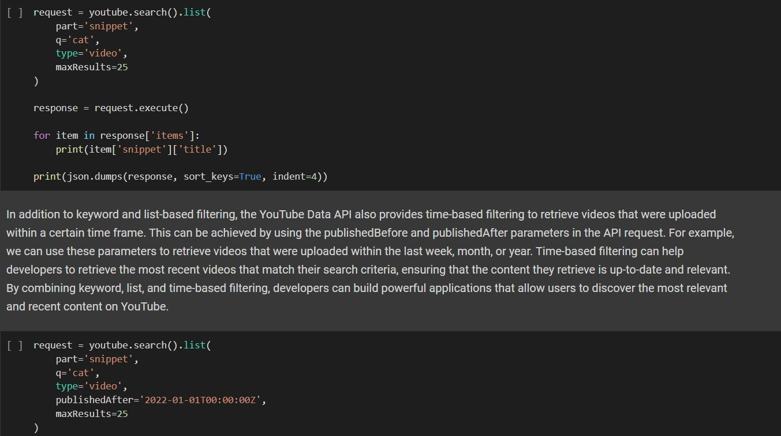

Slide 9
